Slide 1
Office 365 Development

Slide 2


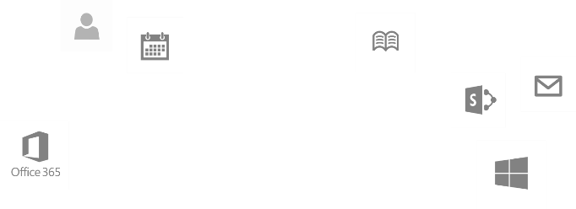
Recap
Introduction to Office 365 development
Module 1: Introduction to Office 365 development
Module 2: Getting started with Apps for Office
Module 3: Getting started with Apps for SharePoint
Module 4: Moving Full Trust Code to the Cloud Using Repeatable Patterns and Best Practices
Module 5: Getting started with the Microsoft Graph API
dev.office.com/training

Slide 3
Deep Dive into Microsoft Graph for Contacts

Slide 4

Agenda
Overview
Paging Support
Batching Support
Exchange Operations using REST

Slide 5
Developer vision
USERS
DATA
HTML

Slide 6
Overview

Slide 7
Microsoft Graph for Calendar, Mail and Contacts
Microsoft Graph
Mail Messages
Contacts
Calendar Events
Microsoft Graph accessible through REST
https://graph.microsoft.com/v1.0/me/messages
https://graph.microsoft.com/v1.0/me/contacts
https://graph.microsoft.com/v1.0/me/events

Slide 8
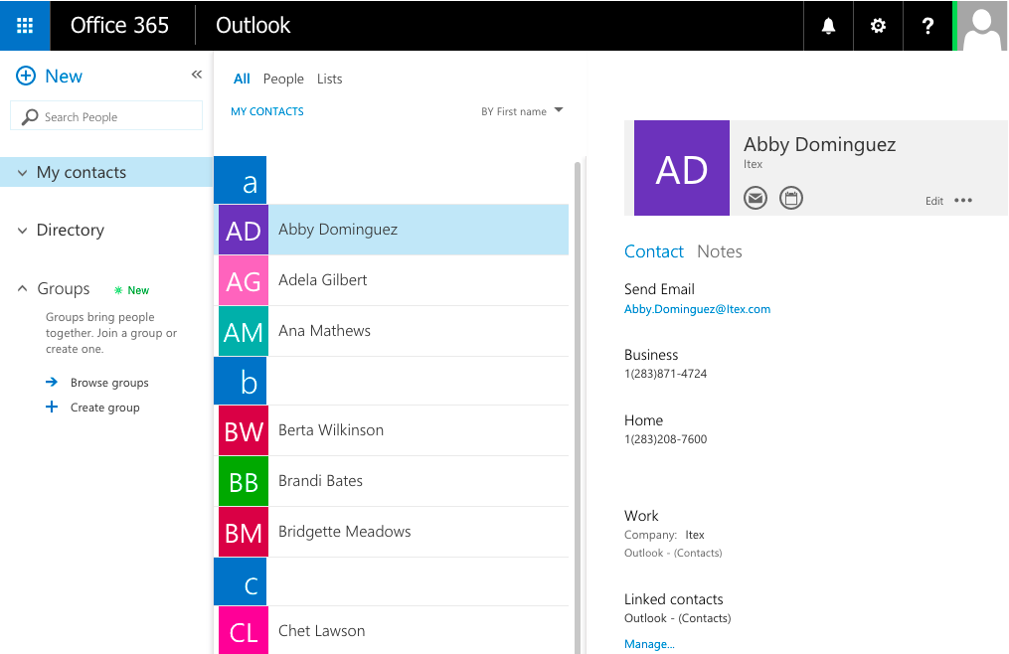
Mailbox Contacts
Common API operations
Creating contacts
Deleting contacts
Editing contacts

Slide 9
Batching with REST

Slide 10
REST is More Chatty than CSOM
Each action is sent as a separate request
CSOM allows for multiple requests to be sent as one
Requests are expensive & slow your app

Slide 11
Batching Support Added to O365
Microsoft Graph shipped with support for REST APIs
Batching requests with REST support added to SharePoint Online late 2014
Send multiple write & read operations in one HTTP request
SharePoint 2013 on-premises – not supported

Slide 12
Exploring the Impact

Slide 13
Overview - Batch Request
BATCH REQUEST
CHANGESET - HTTP POST
CHANGESET - HTTP PATCH
CHANGESET - HTTP DELETE
HTTP GET

Slide 14
Overview - Batch Response
BATCH RESPONSE
CHANGESET RESPONSE
CHANGESET RESPONSE
CHANGESET RESPONSE
HTTP GET RESPONSE

Slide 15
Exchange Operations with Microsoft Graph

Slide 16
Microsoft Graph
https://graph.microsoft.com/v1.0/me/drive/root/children
https://graph.microsoft.com/v1.0/me/messages
https://graph.microsoft.com/v1.0/me/events
https://graph.microsoft.com/v1.0/me/events(<event_id>)
https://graph.microsoft.com/v1.0/me/calendar
https://graph.microsoft.com/v1.0/me/calendar/events
https://graph.microsoft.com/v1.0/me/calendars(<calendar_id>)/events
https://graph.microsoft.com/v1.0/me/contacts
https://graph.microsoft.com/v1.0/me/contacts(<contact_id>)

Slide 17
Reading Entities using REST
HTTP GET request to collection or entity endpoint
Microsoft Graph only returns JSON responses
Paging is accomplished using $skip and $top
public async Task<List<MyContact>> GetContacts(int pageIndex, int pageSize)
{
var contactsResults = new List<MyContact>();
var accessToken = await GetGraphAccessTokenAsync();
var restURL = string.Format("{0}me/contacts?$top={1}&$skip={2}", SettingsHelper.GraphResourceUrl, pageSize, pageIndex * pageSize);
using (HttpClient client = new HttpClient())
{
var accept = "application/json";
client.DefaultRequestHeaders.Add("Accept", accept);
client.DefaultRequestHeaders.Authorization = new AuthenticationHeaderValue("Bearer", accessToken);
using (var response = await client.GetAsync(restURL))
{
if (response.IsSuccessStatusCode) {
var jsonresult = JObject.Parse(await response.Content.ReadAsStringAsync());
foreach (var item in jsonresult["value"]) {
contactsResults.Add(new MyContact
{
Id = !string.IsNullOrEmpty(item["id"].ToString()) ? item["id"].ToString() : string.Empty,
GivenName = !string.IsNullOrEmpty(item["givenName"].ToString()) ? item["givenName"].ToString() : string.Empty,
…
});
}
}
}
}
MorePagesAvailable = contactsResults.Count < pageSize ? false : true;
return contactsResults;
}
Notes:
No support for $skip and $orderby so paging is post-query

Slide 18
Adding a new Entity
HTTP POST to collection endpoint to add an entity
public async Task AddContact(MyContact myContact)
{
var accessToken = await GetGraphAccessTokenAsync();
var restURL = string.Format("{0}me/contacts", SettingsHelper.GraphResourceUrl);
try
{
using (HttpClient client = new HttpClient())
{
var accept = "application/json";
client.DefaultRequestHeaders.Add("Accept", accept);
client.DefaultRequestHeaders.Authorization = new AuthenticationHeaderValue("Bearer", accessToken);
string postBody = JsonConvert.SerializeObject(myContact);
using (var response = await client.PostAsync(restURL, new StringContent(postBody, Encoding.UTF8, "application/json")))
{
if (response.IsSuccessStatusCode)
return;
else
throw new Exception("add contact error: " + response.StatusCode);
}
}
}
catch (Exception el)
{
el.ToString();
}
}

Slide 19
Deleting an Entity
HTTP DELETE to specific entity endpoint
public async Task DeleteContact(string id)
{
var accessToken = await GetGraphAccessTokenAsync();
var restURL = string.Format("{0}me/contacts('{1}')", SettingsHelper.GraphResourceUrl, id);
try
{
using (HttpClient client = new HttpClient())
{
var accept = "application/json";
client.DefaultRequestHeaders.Add("Accept", accept);
client.DefaultRequestHeaders.Authorization = new AuthenticationHeaderValue("Bearer", accessToken);
using (var response = await client.DeleteAsync(restURL))
{
if (response.IsSuccessStatusCode)
return;
else
throw new Exception("delete contact error: " + response.StatusCode);
}
}
}
catch (Exception el)
{
el.ToString();
}
}

Slide 20
demo
Exchange Operations using the Microsoft Graph

Slide 21
Summary
Overview
Paging Support
Batching Support
Exchange Operations using REST

Slide 22
Developer Program Launch
1 YEAR FREE
E-mail Newsletters
Free Developer Subscription
Free Training
Free Tools
Webinars
http://dev.office.com/devprogram

Slide 23


Engage
Office 365 Network
https://www.yammer.com/itpronetwork
Twitter
S
S
t
t
a
a
r
r
t
t
@OfficeDev
Stack overflow
[ms-office]
Channel 9 Dev Show
http://aka.ms/O365DevShow
Podcasts http://dev.office.com/podcasts
Snack Demos
http://aka.ms/o365DevSnackDemos
UserVoice
http://officespdev.uservoice.com/

